Slide 1




Integrated Neighbourhood Teams & Working
Voluntary Sector Children and Youth Forum
23rd September 2025
www.towerhamletstogether.com #TH2GETHER

Slide 2


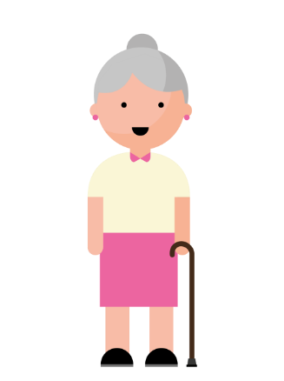

Context
At a national and system level it is increasingly recognised that neighbourhood working will be the vehicle to address growing demographic pressures, improving population health and reducing health inequalities.
Neighbourhoods will be a key enabler to delivering the three shifts that are a strategic priority for the NHS: from hospital to community; from treatment to prevention; from analogue to digital.
The recently published 10 year Health Plan describes bringing care into local communities, convening professionals into multi-disciplinary teams and reintegrating healthcare into the social fabric of Places.
We will use the neighbourhood footprint to address health inequalities; to bring together networks of practitioners working together through local relationships and awareness of community; to develop integrated teams operating in an integrated service model (or team of teams) and to facilitate services working together at a neighbourhood level with improved interfaces to acute and other services.
It will bring care into local communities, convene professionals into patient-centred teams and end fragmentation.
Locally, there is already a huge amount of great, integrated work already happening in neighbourhoods across the borough. We aim to build on these strengths through this work.

Slide 3
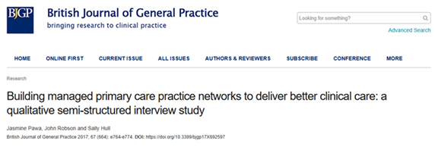
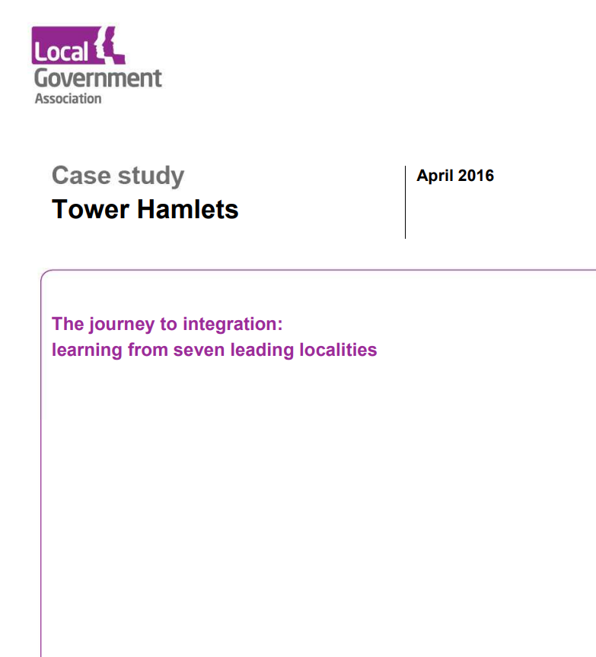
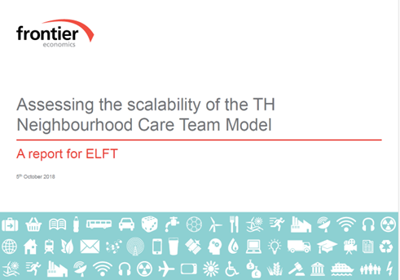
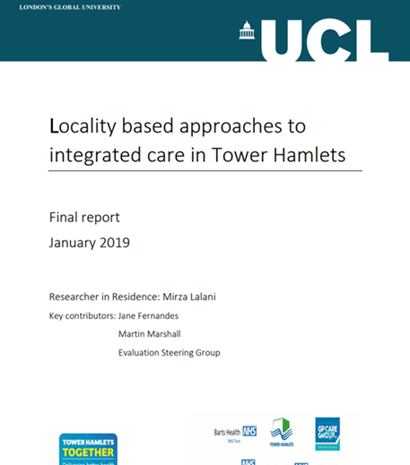
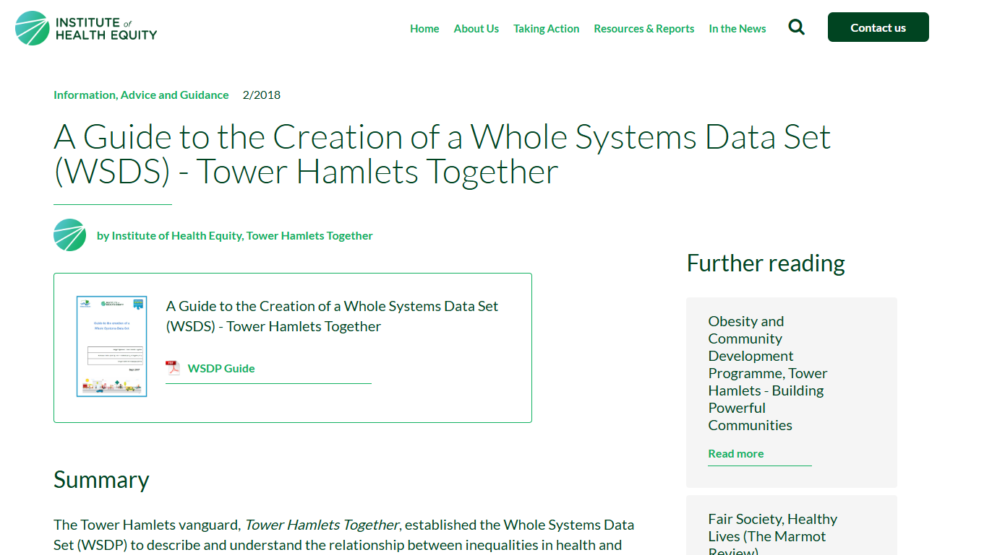
Our Shared History…
1997 – 2002
Children and adults social care neighbourhood teams
2006 - 08
Primary care improvement programme
2012 - 14
Waltham Forest & East London integrated care programme
2015 - 18
Multi-specialty community vanguard (THIPP)
2016 -
Community Health Services (CHS) contract
2019 -
Primary Care Networks (PCNs)
2021 - 24
Community mental health service transformation
2022 -
Neighbourhoods 2.0 (Fuller, Streeting, Darzi, NHS 10 year plan)

Slide 4
What Is It?
Integrated Neighbourhood Working
- Centred on relationships, trust, and deep knowledge of the community
- Focused on prevention, joined-up care, and reducing health inequalities
- A culture and shared way or working which allows coordination across health, social care, public health, housing, VCS, community leaders, and residents
- Creates a sense of belonging where residents feel seen, supported, and part of a thriving neighbourhood
Integrated Neighbourhood Team
- Local, multi-partner teams and professionals working together to support people’s health and wellbeing
- In the first phase, a core team will be shaped by the local priorities and cohorts in each neighbourhood
- A core NHS expectation and a practical way to deliver person-centred support
The methodology
The unit of delivery

Slide 5
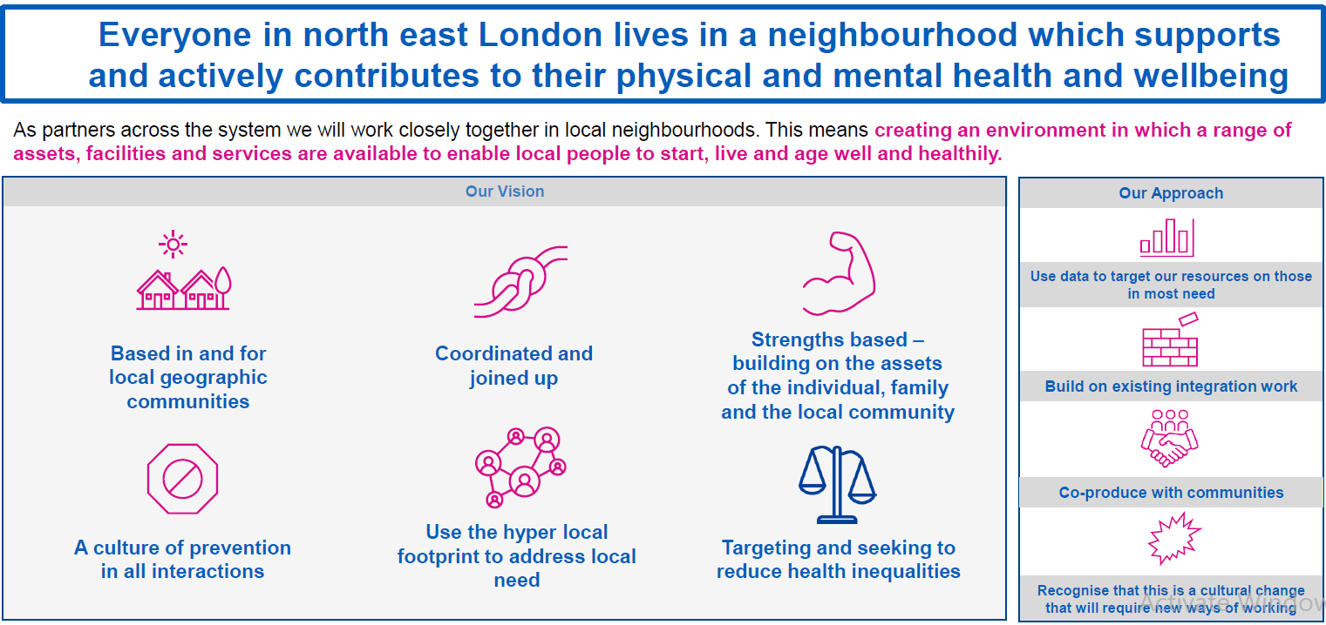
NEL Vision

Slide 6
Our Mission (work in progress, to be road tested)
We want every resident to feel part of a thriving neighbourhood where they are known, supported, and able to live healthily and happily. Together, we will provide joined-up, person-centred care through local teams rooted in the community.
If we get this right, residents will say “I can plan my care with people who work together to understand me and my carer(s), allow me control, and bring together services to achieve the outcomes important to me.”

Slide 7
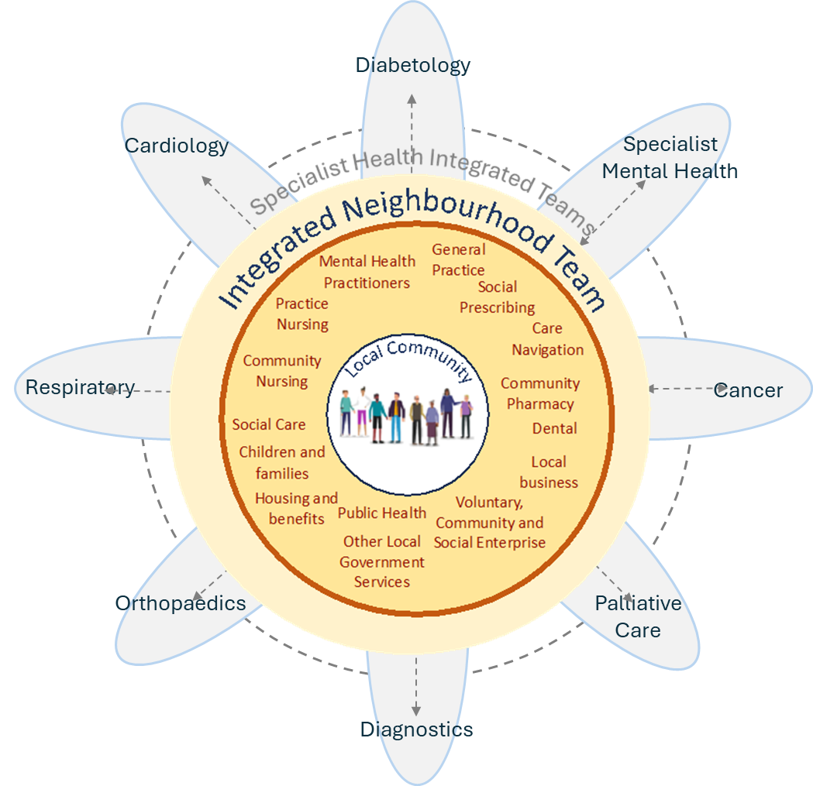
Who is involved?
All THT partners and the breadth of the VCS will be involved
Each of the neighbourhood teams will have its own core health and care team
In the first phase, these teams will be shaped by local priorities and population needs
Over time, each INT will grow to include all partners contributing to residents’ health and wellbeing including those working on wider determinants like housing, employment and environment
Source: National Association of Primary Care

Slide 8
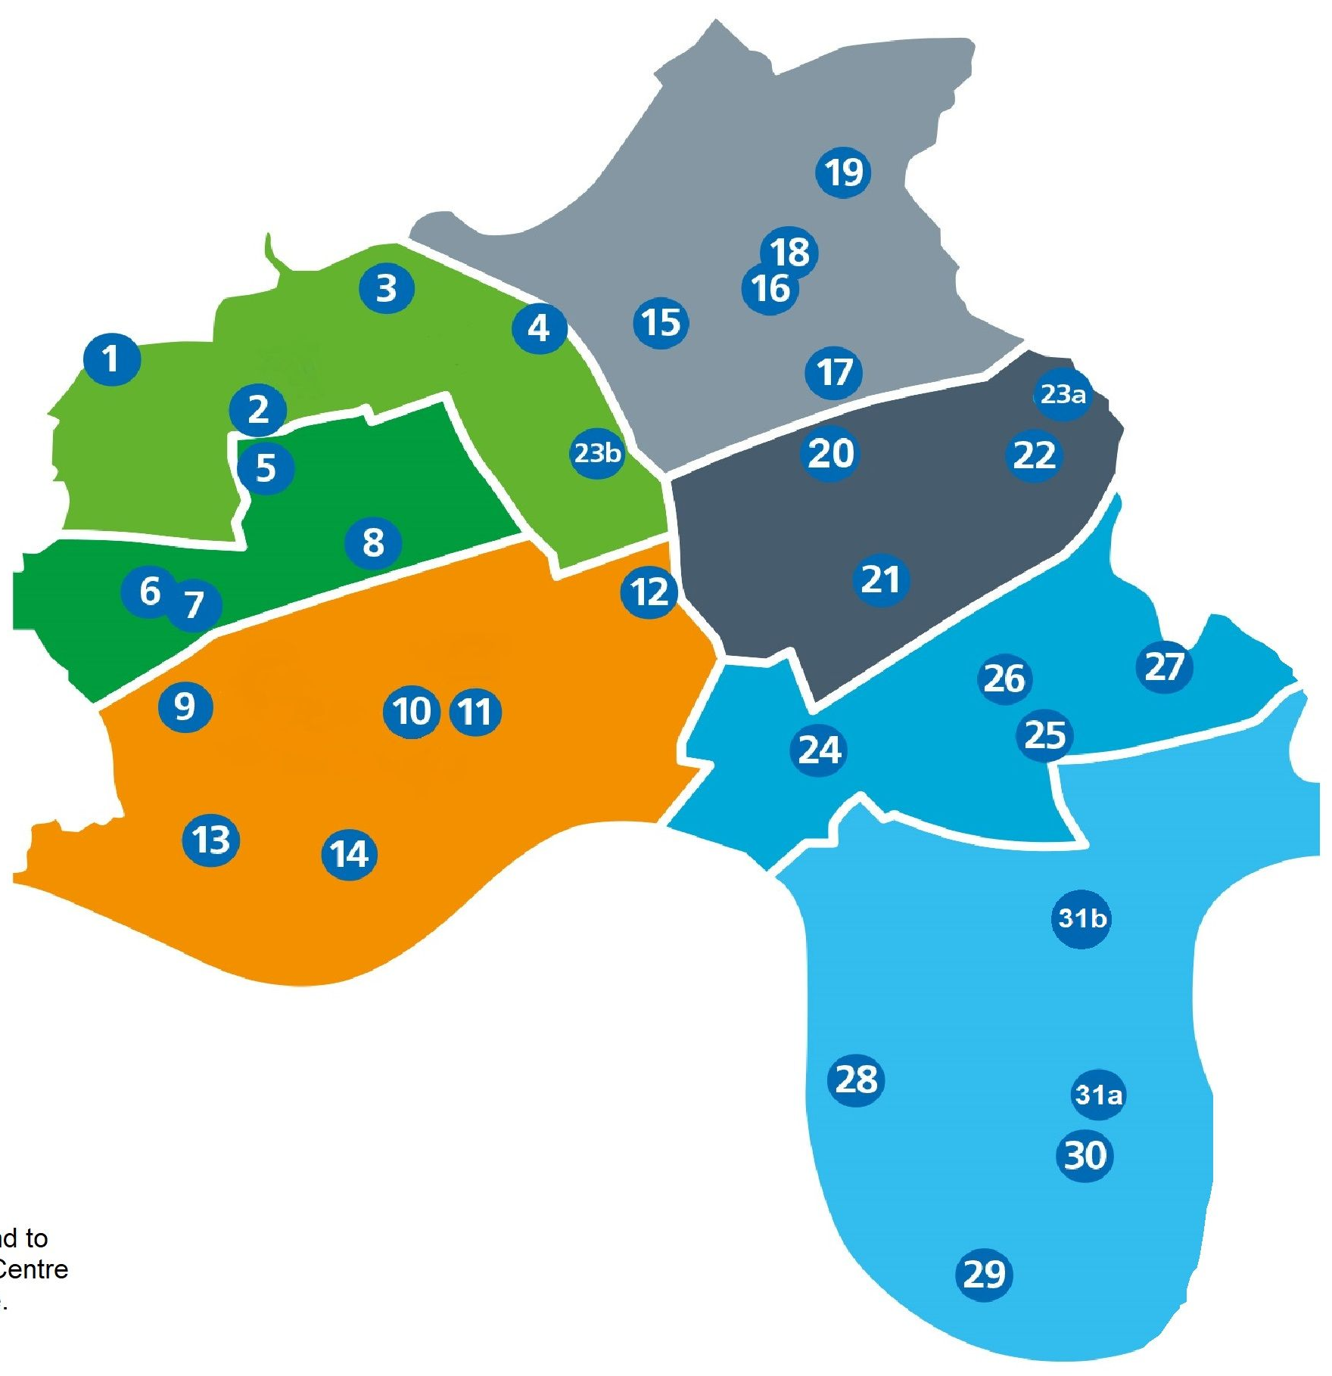
What are we aiming for?
Teams feel trusted and empowered to be bold, experiment, make mistakes, and learn together
Shared leadership and priorities across health, care, and community
Visible impact on resident experience, equity, and system pressure
More joined-up, person-centred care in the community
Residents will receive timely, holistic support — with fewer delays, repeat referrals and crises
Partners who contribute to the wider determinants of health and wellbeing are embedded in the model
Communities are supported to build on their strengths and equipped to live healthy lives

Slide 9
How do we want to work together to make this happen?
Place trust in teams and give them freedom to set priorities and design solutions
Be champions in our own organisations for INTs and actively engage throughout
Deliver by doing, nurturing the energy
Ensure a fully engaged and involved approach including residents, clinical and care professionals, VCSE providers and broader networks (e.g. housing, leisure)
Use evidence-based approaches (e.g. quality improvement)
Use data for insights & measurement (e.g. EDITH (LBTH), Optum (ICB) population health management approach)
Focus on the things that we know helps teams to flourish
Focus on eliminating waste
Focus on prevention

Slide 10
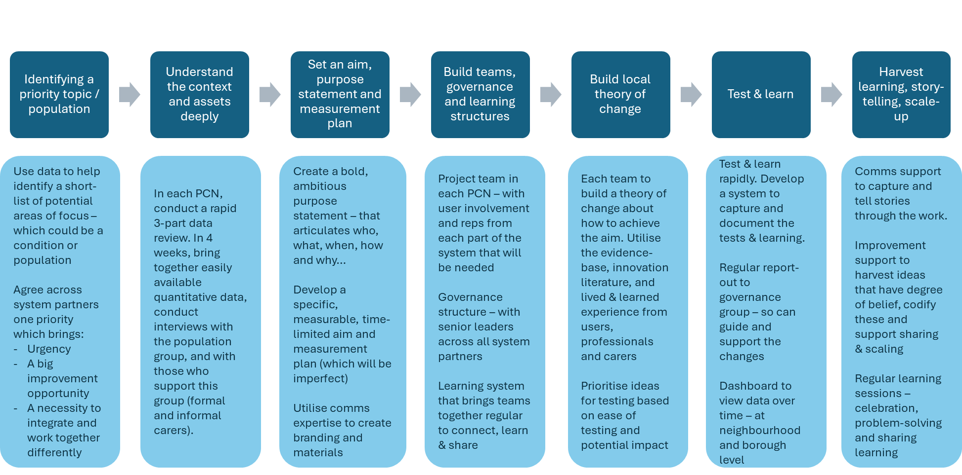
Phase one detailed approach – learning through testing

Slide 11
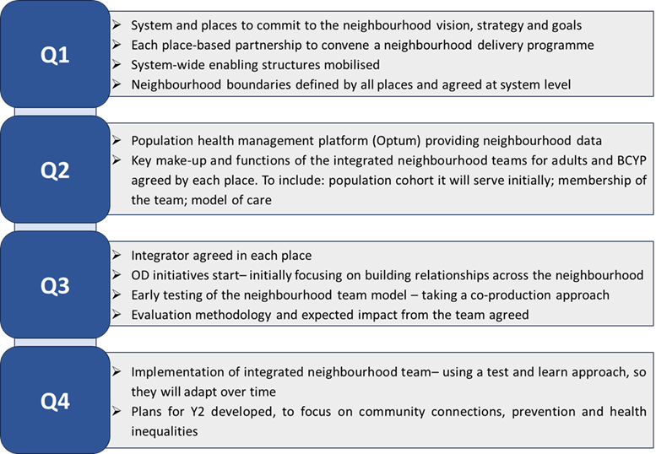
North East London ICB 2025/26 Roadmap
Tower Hamlets Progress
Complete
In progress
To be started
To be started

Slide 12
What is the longer-term plan for transformation?
1
2
3
4
Q1-4, 2025/26
Q1-Q2, 2026/27
Q3-Q4, 2026/27
2027/28 and beyond
In this phase, each INT will bring partners together to test neighbourhood working around a locally selected population or pathway.
In this phase, we will explore the feasibility of expanding the populations or pathways each INT covers.
We will also begin workforce modelling to understand current variation and help shape what our future ‘end state’ might look like
In this phase, we will continue to evolve and expand the role of INTs.
We will begin to define the ‘core offer’ and develop a target operating model for each INT.
We will also agree our approach to organisational development (OD) and managing change across the system.
In this phase, we will focus on implementing and embedding our target operating model for each INT
We are here

