Slide 1


Slide 2

Neighbourhood Forum Pilot PCN 1 & 2
Part of Tower Hamlets Together’s Localities & Neighbourhoods programme. The programme has been delivered by THCVS in partnership with local VCS organisations:
Social Action For Health St Margarets House
Womens Inclusive Team Somali Senior Citizens Club

Slide 3
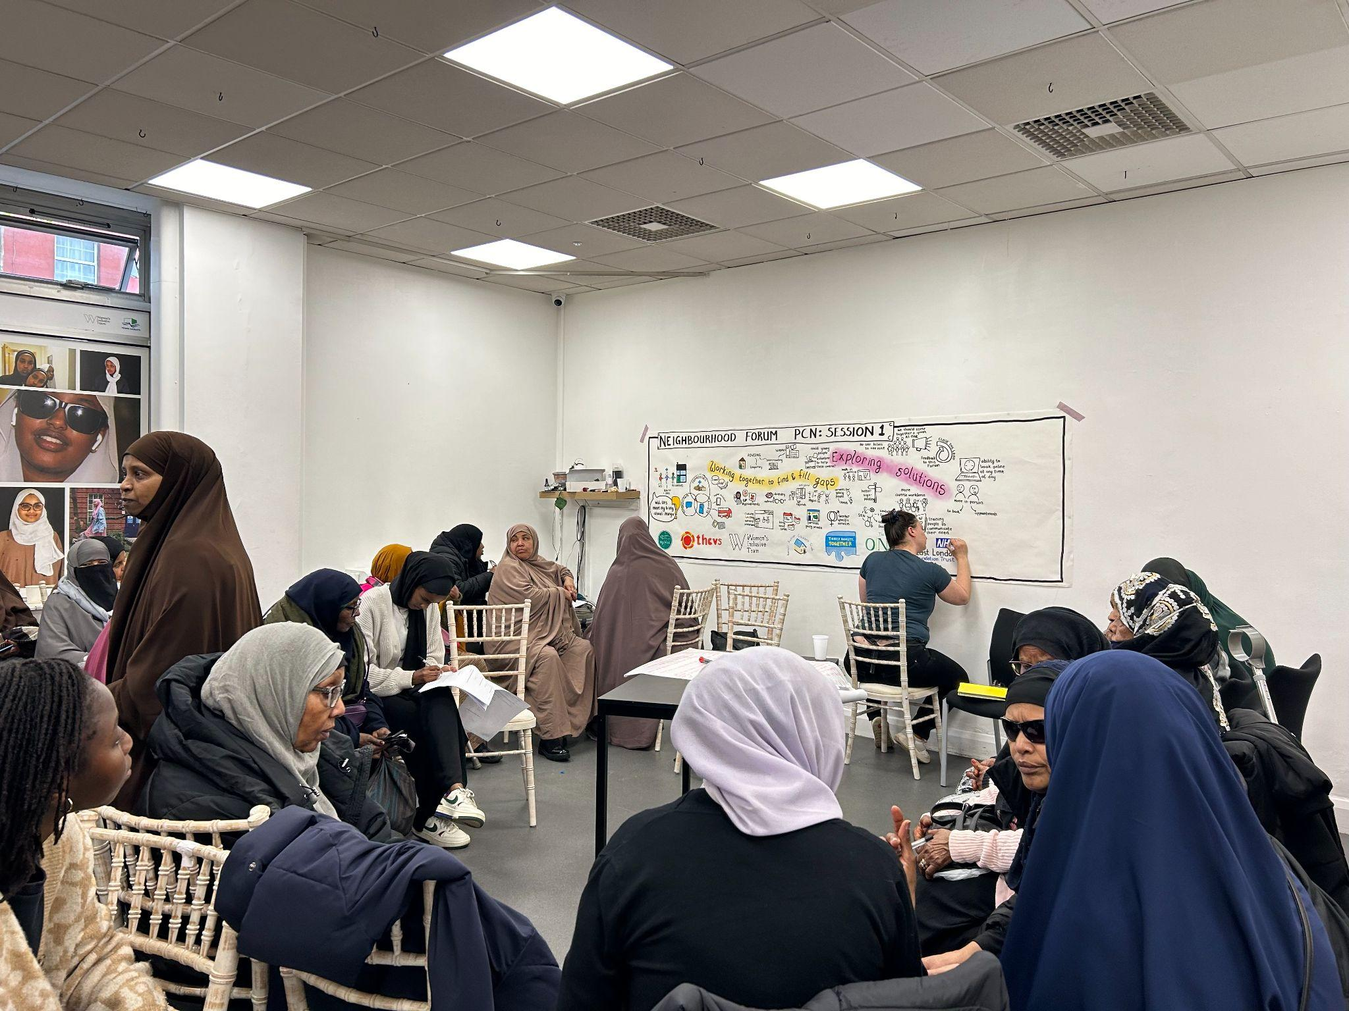
Aims of the programme
Building a sustainable place-based approach to addressing the health needs of communities.
Developing structures that would embed resident voice in health-related decision making at a local level

Slide 4
What have we done so far?
3 phases:
1. Co-design phase
brought together local residents, local VCS organisations, and health professionals to co- design outcomes for the Neighbourhood Forum and principles for how they would be organised.
  2. 1st Neighbourhood Forum meetings
  These sessions were focused upon identifying barriers to residents’ ability to access primary care services and potential solutions to overcoming these barriers. Attended by 95 residents and health partners
  3. Action plan development and implementation
  focused upon co-producing with residents answers to questions of access around the Interpreting & Advocacy Service and Youth Health Literacy

Slide 5
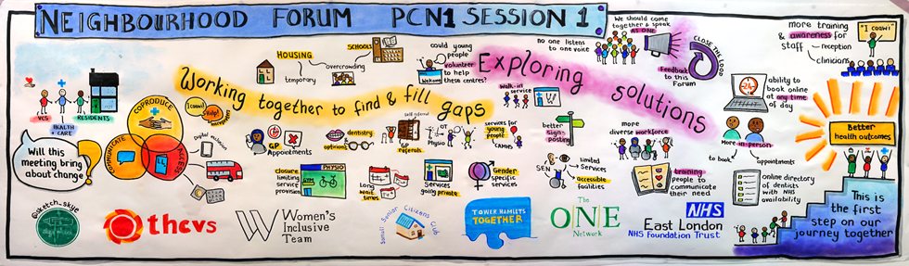
PCN1 Visual minutes

Slide 6
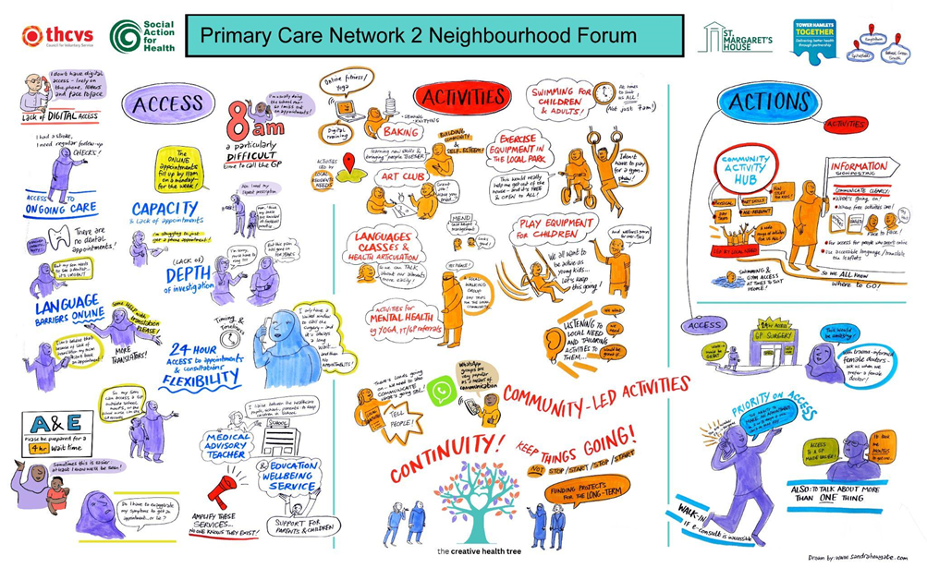
PCN2 Visual Minutes

Slide 7
Focus Group Insights
Recent Health literacy Focus Group Session
There was a total of 9 attendees – age range 13-21 years old
Provided valuable insight into how young people engage with health messaging and highlighted key themes for improving outreach and impact.

Slide 8
Key Findings:
Preference for In-Person Engagement
Young people prefer workshops, pop-ups, and interactive sessions over leaflets or posters.
Suggested Locations - Schools (Years 7–10), youth clubs, and community hubs.
Vital 5 - (healthy Tower Hamlets) Messages Not Resonating
Messaging is not memorable, personal, or meaningful. Need short, impactful, relatable messages. Can only relate to 3 of the vital 5.
Three Most Meaningful Topics
  1 .Mental Health – Wellbeing activities (mindfulness, art, movement), peer support.
  2. Healthy Eating – Focus on energy and mood, not weight/appearance.
  3. Addiction – Vaping seen as low-risk; little awareness of long-term impact.
Vaping Concerns
Easy access, minimal consequences, low awareness of addiction risks.

Slide 9
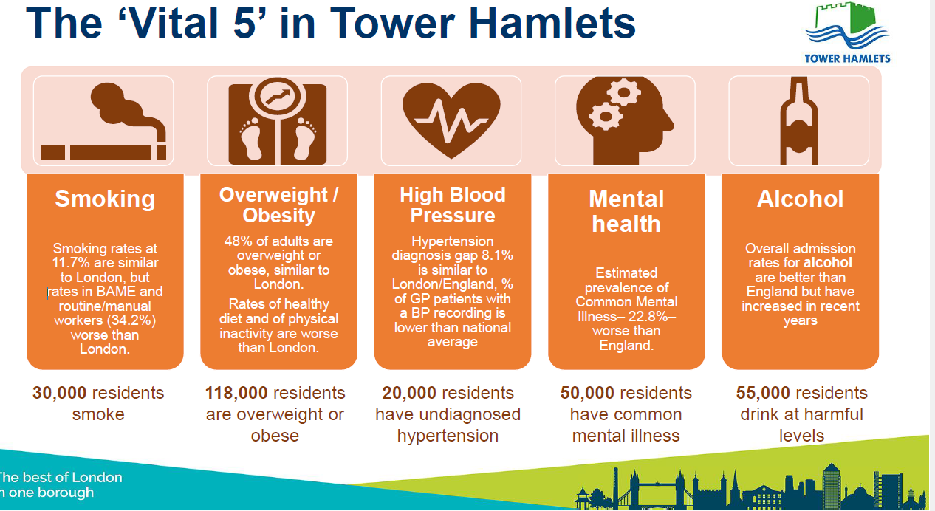

Slide 10
Next Steps
Interactive, Peer-Led Workshops
Focus on mental health, healthy lifestyle choices, and addiction awareness.
Relatable Health Messaging
Short, impactful messages that connect with young people’s real-life experiences.
Increase Addiction Education
Stronger focus in secondary schools, especially vaping risks.

