Slide 1


VCFSE Collaborative State of the Sector
5,534 local and regional voluntary and community groups.
Most are small organisations (under £100,000pa)
22,626 charity employees
98,247 charity volunteers
14,992 charity trustees
Total income was £1.74 billion.

Slide 2
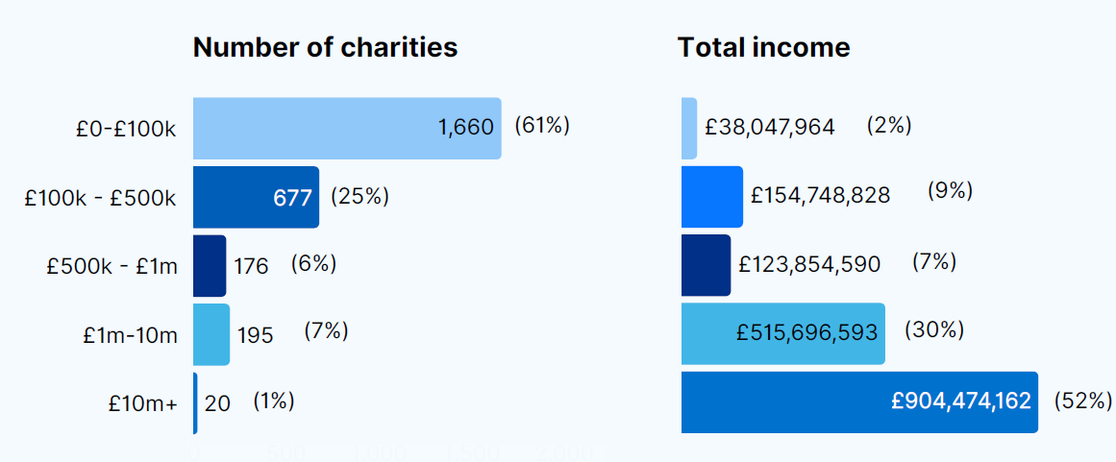
Distribution of income by size of organisation

Slide 3
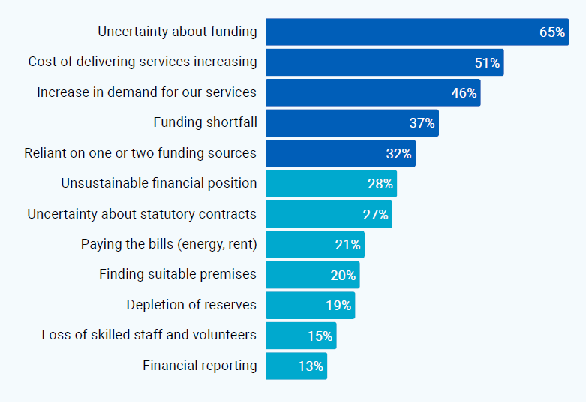
Biggest concerns for financial sustainability

Slide 4
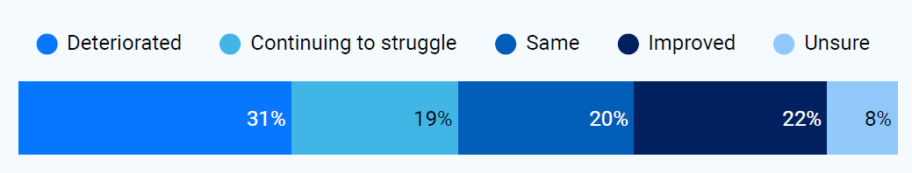
Worsening financial position for local and regional groups

Slide 5
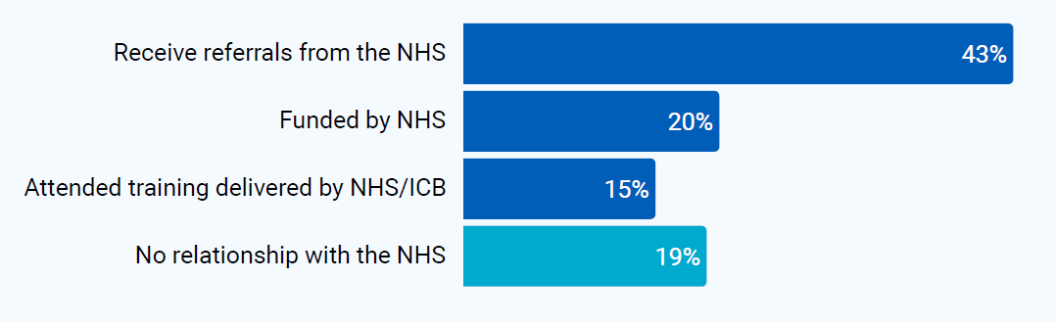
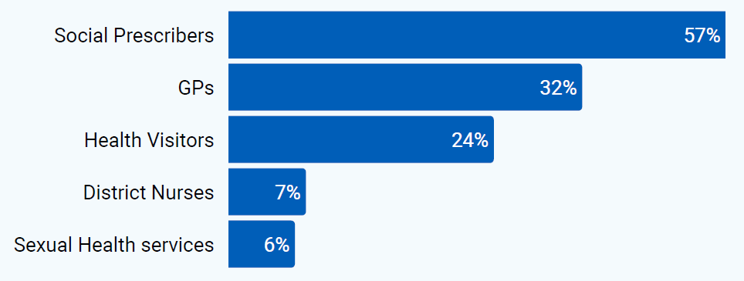
Relationships with health

Slide 6
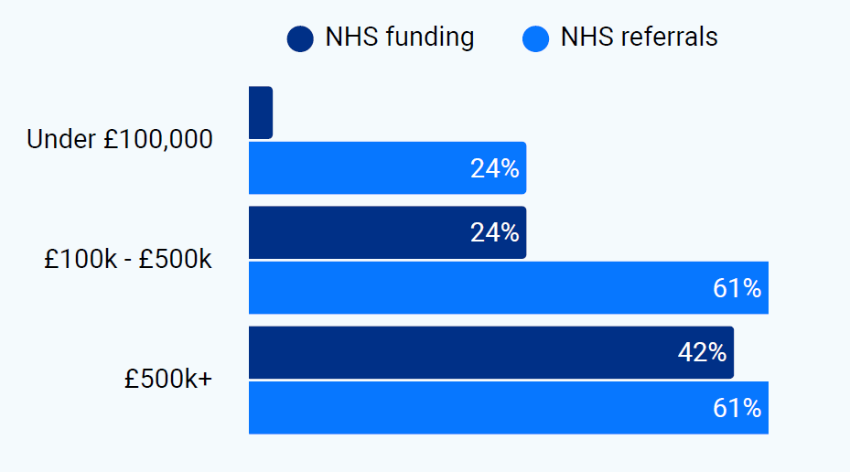
NHS funding varies by size of organisation

Slide 7
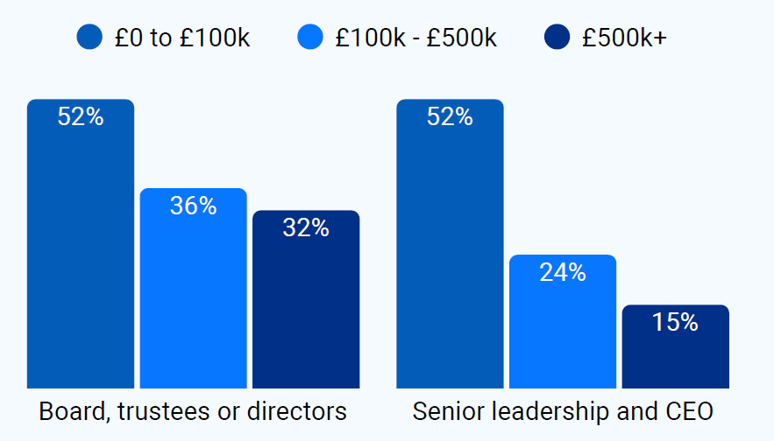
Global Majority representation varies by size of organisation

Slide 8
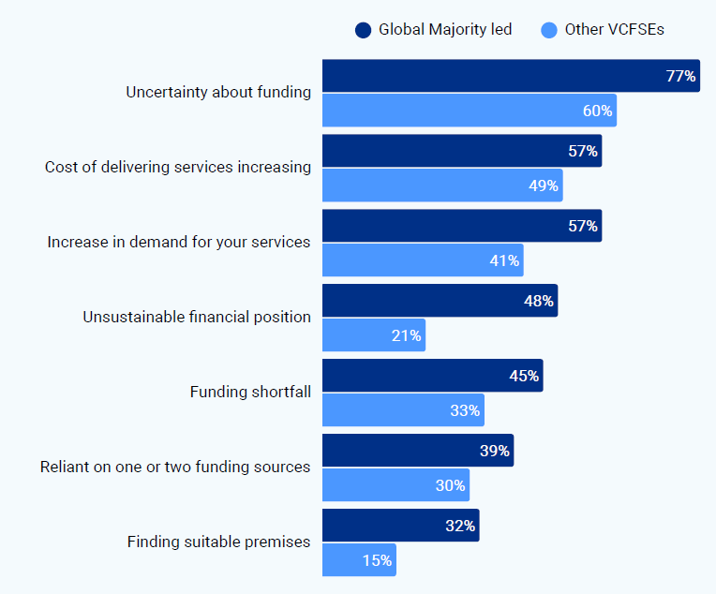
The financial position of Global Majority VCS groups

Slide 9
You can find the full State of the Sector report here:
https://thcvs.org.uk/wp-content/uploads/2025/09/State-of-Sector-NEL-VCFSE.pdf
NEL VCFSE Collaborative: NEL VCFSE Collaborative – Tower Hamlets CVS

